Slide 1
Natural Language Processing and
Speech Recognition

Slide 2
Text Data Analysis

Slide 3

Understand the NLP pipeline for text processing and classification
Discuss different methodologies for data acquisition
Implement text cleaning and text pre-processing steps
Learn to extract features from text data
Implement sentiment analysis and classification in python

Slide 4
NLP Pipeline

Slide 5

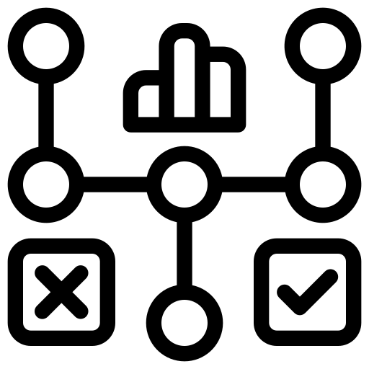







NLP Pipeline
An NLP pipeline is a sequence of processing steps that are applied to a text document to extract useful information and insights.
Deployment
Evaluation
Monitoring
Data acquisition
Model building
Text generation
Feature engineering
Text cleaning
Text
pre-processing

Slide 6
Data Acquisition

Slide 7
NLP Pipeline: Data Acquisition
Text data acquisition involves the systematic collection of textual information from various sources.
Text data can be acquired using the following ways:
Web scrapping
Application programming interfaces (APIs)
Data augmentation
Text data acquisition
PDF to text
Image to text

Slide 8

Data Acquisition: Web Scraping
Web scraping involves extracting text data from websites. In python, web scraping is facilitated through libraries like BeautifulSoup, Scrapy, etc.
HTML WEBSITES
WEB SCRAPING
DATA
Be mindful of ethical considerations and ensure compliance with legal regulations.
Note

Slide 9
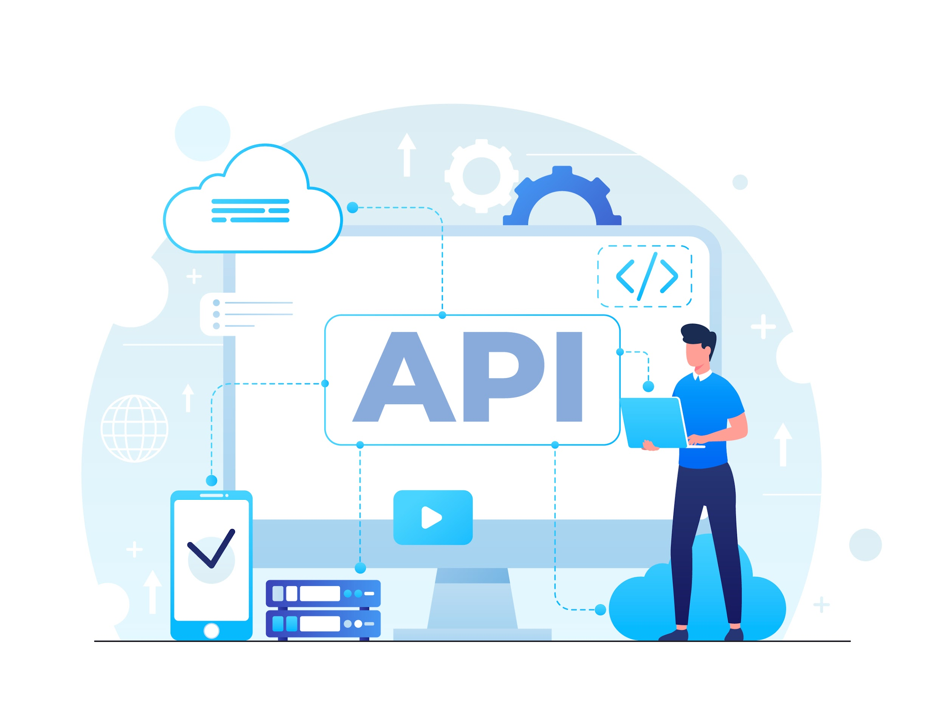

Data Acquisition: Application Programming Interfaces (APIs)
Application programming interfaces (APIs) play a crucial role in text data acquisition, providing structured access to information from various sources.
APIs enable developers to programmatically retrieve textual information from various sources.
Online services like Twitter and Google Maps offer such APIs for retrieval textual information from these platforms.

Slide 10




Data Acquisition: Image to Text
Computer vision and optical character recognition (OCR) are used to extract text content present in images.
OCR
Text Document
Tesseract library of python utilizes OCR technology to convert images into textual data.

Slide 11


Data Acquisition: PDF to Text
PDF is a common format for storing textual data due to its versatility and ability to maintain document formatting.
Many documents, including reports, articles, and manuals, are often distributed or archived in PDF format.
In python there are various libraries can be used to extract text from PDF files, which include PyMuPDF, PyPDF2, pdfminer.six, PyPDFium, etc.
Notes:
When working with such data, extracting and converting the text from PDF files becomes crucial for analysis, search, and other text-related tasks. Various tools and libraries can be employed to perform PDF to text conversion, enabling efficient handling of the textual content stored in PDF documents.

Slide 12
Data Acquisition: Data Augmentation
Data augmentation refers to the process of artificially expanding a dataset by generating diverse variations of existing textual data.
Data augmentation techniques aim to improve the robustness and generalization of machine learning models.
Commonly used techniques include text synonym replacement, back translation, and random swap, among others.

Slide 13
Text Cleaning and Text Preprocessing

Slide 14





Text Cleaning and Pre-processing Steps
Like any other type of data source, text data also requires cleaning and preprocessing. Below are some of the typical steps in text cleaning and preprocessing:
Stemming and lemmatization
Named entity recognition
Tokenization
Noise entity removal
Part of speech tagging
Note
Python libraries like regular expression (re), natural language toolkit (NLTK), and SpaCy are used here.

Slide 15


Tokenization
Tokenization involves segmenting unstructured data and natural language text into distinct units or elements, shaping the foundation for further analysis.
Let's consider the sentence:
"Natural language processing is a fascinating field."
Tokenization of this sentence would involve breaking it down into individual words or tokens:
["Natural", "language", "processing", "is", "a", "fascinating", "field", "."]

Slide 16
Text Cleaning
The text data contains a lot of noise. These entities don't contribute any value to the analysis and therefore should be removed from the text. These noise entities include:
"Stop words refer to common words that are often removed during text preprocessing to focus on more meaningful terms.
Common stop words in English include 'the,' 'and' 'is,' 'in,' 'it,' 'for,' 'to,' 'of,' 'with,' and 'that’.
Stop Words

Slide 17
Text Cleaning
The text data contains a lot of noise. These entities don't contribute any value to the analysis and therefore should be removed from the text. These noise entities include:
Punctuation marks like commas (,), periods (.), exclamation marks (!), question marks (?), semicolons (;), colons (:) are often eliminated to simplify the text and reduce noise.
This allows the model to focus on meaningful content.
Punctuation

Slide 18
Text Cleaning
The text data contains a lot of noise. These entities don't contribute any value to the analysis and therefore should be removed from the text. These noise entities include:
Special characters
The symbols @, #, $, %, ^, & etc are often removed to reduce noise and simplify the text for analysis.

Slide 19
Stemming and Lemmatization
Stemming and lemmatization serve to simplify text by reducing words to their fundamental forms, aiding in the reduction of vocabulary size.
Stemming
Lemmatization
leafs
leaf
leafs
leaf
leaves
leav
leaves

Slide 20
Stemming
Stemming generally refers to a straightforward heuristic approach that shortens word endings with the goal of achieving accurate results most of the time, often involving the removal of derivational affixes.
Original Work | Stemming Result
Jumps | Jump
Flying | Fly
Running | Run

Slide 21
Stemming Variants
Stemming operation can be performed using several algorithms. The most used algorithms include:
Porter Stemmer
It was introduced in 1980 and stands out as one of the most widely adopted stemming methods.
Its approach revolves around the concept that English language suffixes consist of combinations of smaller, simpler suffixes.
Renowned for its speed and simplicity, it remains a popular choice in various applications.

Slide 22
Stemming Variants
Stemming operation can be performed using several algorithms. The most used algorithms include:
Snowball Stemmer
Snowball stemmer also known as a multi-lingual stemmer, extends its reach beyond English words.
Its approach revolves around the concept that English language suffixes consist of combinations of smaller, simpler suffixes.
Renowned for its speed and simplicity, it remains a popular choice in various applications.

Slide 23
Lemmatization
Lemmatization involves reducing words to their basic form by utilizing vocabulary and morphological analysis, with the goal of returning the base or dictionary form of a word, referred to as the lemma.
WordNet Lemmatizer
(NLTK)
TextBlob Lemmatizer
An early and extensively utilized lemmatizer leveraging a vast, freely accessible lexical database for the English language.
A robust, speedy, and user-friendly NLP package that internally employs WordNet for lemmatization.

Slide 24
Stemming vs Lemmatization
The decision between stemming and lemmatization relies on the requirements and objectives of the specific natural language processing (NLP) task.
 | Stemming | Lemmatization
Linguistic Analysis | Rule-based and does not consider the context or part of speech. | Lemmatization considers the context and grammatical structure.
Output Form | Stemming may result in stems that are not actual words. | Lemmatization always returns valid words from the language.
Computational Cost | Stemming is less precise but computationally faster. | Lemmatization is more accurate but can be computationally more intensive.

Slide 25
Parts of Speech Tagging
Part of speech (PoS) tagging provides essential information about the syntactic and semantic characteristics of words in any given text, enabling more accurate language understanding and processing.
RB
Adverbs
Nouns
NN
DT
Parts of speech
VB
Determiner
Verbs
CC
PRP
Conjuctions
Pronouns
IN
JJ
Prepositions
Adjectives

Slide 26
Parts of Speech Tagging
PoS tagging involves assigning words in a text corpus to specific parts of speech based on their definitions and contextual usage.
Given below is an example for PoS tagging:
Word | Part of speech | Part of speech tag
I | Personal pronoun | PRP
love | Verb, non-3rd person singular present | VBP
coding | Verb, gerund or present participle | VBG
with | Preposition | IN
Python | Proper Noun, singular | NNP
"I love coding with Python."

Slide 27
Named Entity Recognition
NER, or Named Entity Recognition, is like a detective for finding and sorting important things in text.
It looks for specific types of things, such as names of organizations, people, places, and more.
Word | Named Entity
I | Other (O)
visited | Other (O)
Paris | Location (LOC)
last | Other (O)
summer | Other (O)
"I visited Paris last summer."

Slide 28
Feature Engineering

Slide 29
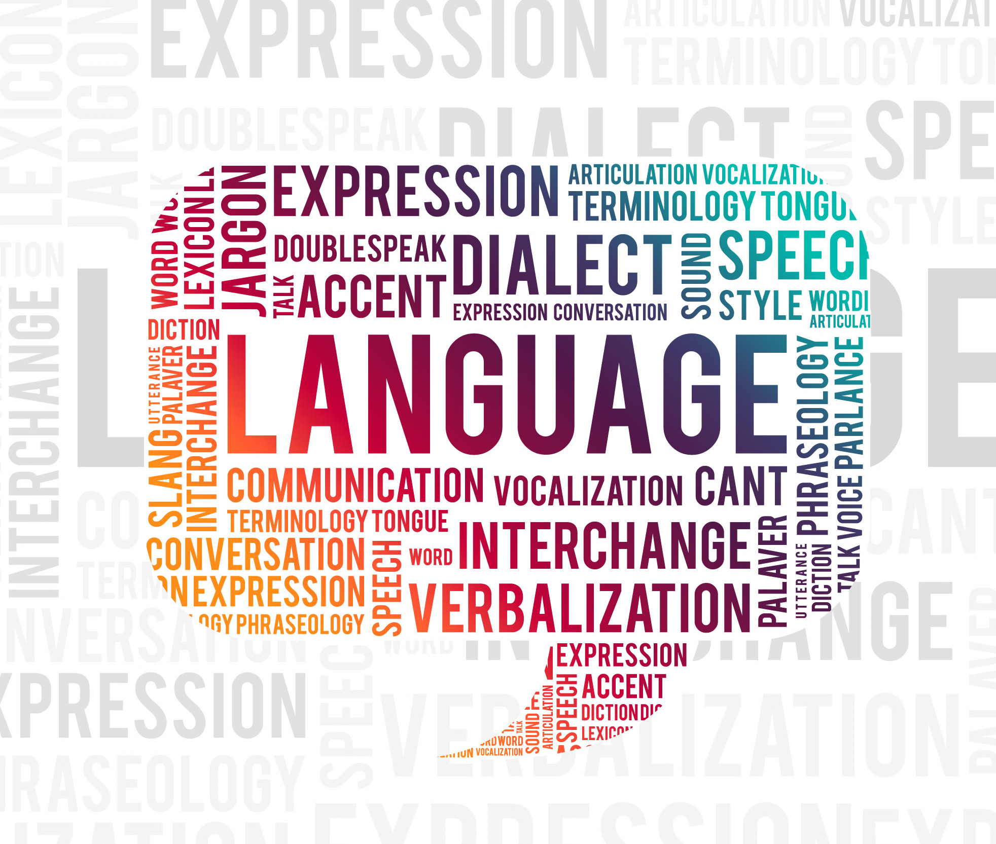
Vocabulary and Feature Extraction
In natural language processing (NLP), vocabulary and feature extraction are fundamental aspects of transforming raw text data into a format suitable for machine learning models.
Vocabulary
The vocabulary comprises the set of distinct words found in a corpus or a collection of texts. It is formed by identifying unique tokens throughout the entire corpus.

Slide 30

Vocabulary
Let’s look at an example of creating vocabulary.
Consider the following statements as input:
Sentence 1: "Text classification identifies document categories."
Sentence 2: "Named Entity Recognition extracts entities from text."

Slide 31

Vocabulary
Let’s look at an example of creating vocabulary.
Obtain tokens from these statements:
Sentence 1: "Text classification identifies document categories."
Sentence 2: "Named Entity Recognition extracts entities from text."
Sentence 1 Tokens: ["Text", "classification", "identifies", "document", "categories"]
Sentence 2 Tokens: ["Named", "Entity", "Recognition", "extracts", "entities", "from", "text"]

Slide 32
Vocabulary
These tokes are then used to create a vocabulary using the unique words from both the sentences.
Sentence 1 Tokens: ["Text", "classification", "identifies", "document", "categories"]
Sentence 2 Tokens: ["Named", "Entity", "Recognition", "extracts", "entities", "from", "text"]
Vocabulary
["categories", "classification", "document", "Entity", "entities", "extracts", "from", "identifies", "Named", "Recognition", "text", "Text"]

Slide 33
Feature Extraction
Text data is inherently unstructured, necessitating conversion into a numerical format for use in machine learning models.
The foundational methods which help to create features from text data include:
Fundamental sparse matrix
Positive and negative frequencies

Slide 34
Feature Extraction: Sparse Matrix
The vocabulary generated previously is used to generate the sparse matrix as below:
Sentence 1: "Text classification identifies document categories."
categories | classification | document | entities | extracts | from
1
1
1
0
0
0
identifies | text | Entity | Named | Recognition | Text
1
0
0
0
0
1

Slide 35
Feature Extraction: Sparse Matrix
The vocabulary generated previously is used to generate the sparse matrix as below:
Sentence 2: "Named Entity Recognition extracts entities from text."
categories | classification | document | entities | extracts | from
0
0
0
1
1
1
identifies | text | Entity | Named | Recognition | Text
0
1
1
1
1
0

Slide 36
Feature Extraction: Sparse Matrix
The vocabulary generated previously is used to generate the sparse matrix as below:
Sentence 1: "Text classification identifies document categories."
Binary vector based on the vocabulary: [ 1, 1, 1, 0, 0, 0, 1, 0, 0, 0, 0, 1 ]
Sentence 2: "Named Entity Recognition extracts entities from text."
Binary vector based on the vocabulary: [ 0, 0, 0, 1, 1, 1, 0, 0, 1, 1, 1, 1 ]

Slide 37
Problems With Sparse Representation
A lot many zeroes create high degree of redundancy in the train data.
Consider the earlier example, the binary vectors created for the two sentences are as below:
Binary vector for sentence 1:
[1, 1, 1, 0, 0, 0, 1, 0, 0, 0, 0, 1]
Binary vector for sentence 2:
[0, 0, 0, 1, 1, 1, 0, 0, 1, 1, 1, 1 ]
Hence, the fundamental sparse representation is highly inefficient for training and testing the model.

Slide 38
Feature Extraction: Positive and Negative Frequency
Positive and negative frequency count is one approach to feature extraction, particularly when working with sentiment analysis or other classification tasks.
Step 1
Step 2
Getting counts for positive and negative occurrences
Feature extraction
Creation of feature vector

Slide 39
Feature Extraction: Positive and Negative Frequency
Step 1
Get the positive and negative frequency count
Create the vocabulary using the statements.
Count the occurrences of each word in the positive and negative documents separately.

Slide 40

Feature Extraction: Positive and Negative Frequency
Step 1
Get the positive and negative frequency count
Consider the example here with three statements as input:
Statement 1:
"I love this movie.”
Statement 2:
"This movie is terrible.”
Statement 3:
“The acting is great.”
positive
negative
positive

Slide 41
Feature Extraction: Positive and Negative Frequency
Step 1
Get the positive and negative frequency count
The positive negative frequency for the statements will be as below:
Vocabulary | Positive count | Negative count
I | 1 | 0
love | 1 | 0
this | 1 | 1
movie | 1 | 1
is | 1 | 1
terrible | 0 | 1
the | 1 | 0
acting | 1 | 0
great | 1 | 0

Slide 42
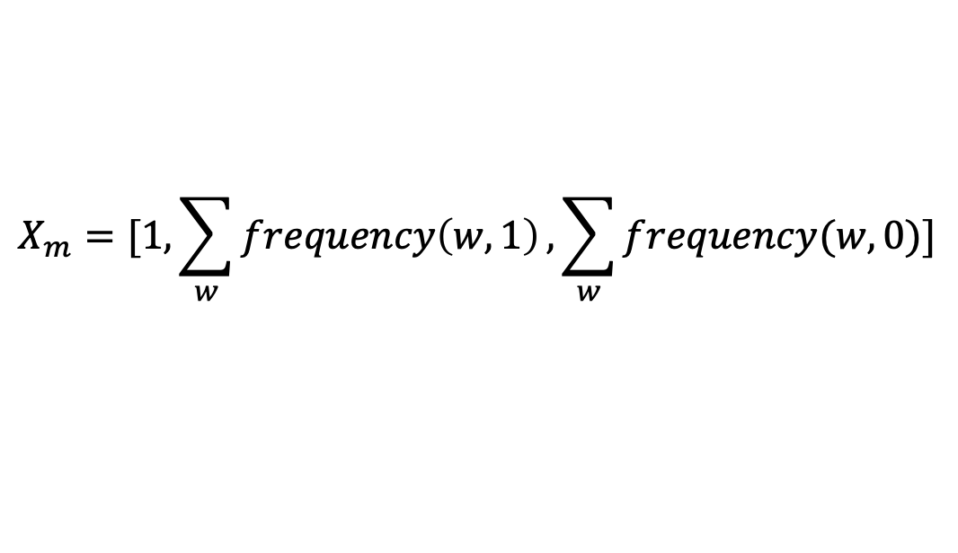
Feature Extraction: Positive and Negative Frequency
Step 2
Creation of feature vector
Now, combine the positive and negative frequency counts to create a feature vector for each document.
Sum of positive frequencies
Sum of negative frequencies

Slide 43
Feature Extraction: Positive and Negative Frequency
Step 2
Creation of feature vector
Based on the positive negative frequencies obtained in the previous step, the feature vector for the input statements is as below:
Sentence | Feature vector
"I love this movie.” | [1, 2, 1]
“This movie is terrible.” | [1, 1, 2]
“The acting is great.” | [1, 2, 0]

Slide 44
Sentiment Analysis in Python

Slide 45

Revisiting Sentiment Analysis
Sentiment analysis, also known as opinion mining, is the process of determining and extracting the sentiment or emotional tone expressed in a piece of text, such as a review, social media post, or comment.
The goal is to understand whether the expressed sentiment is positive, negative, or neutral.

Slide 46
Sentiment Analysis in Python
Python provides various functions in different libraries for performing sentiment classification. These include:
Naïve Bayes classifier (NLTK)
TextBlob sentiment analyzer
Sentiment analysis
Vader sentiment analysis
Flair: text sentiment classifier
Refer to the jupyter notebooks for implementation.

Slide 47
An NLP pipeline is a sequence of processing steps that are applied to a text document to extract useful information and insights.
NLP pipeline includes steps like data acquisition, text cleaning, preprocessing, feature extraction, model development, and deployment.
Data acquisition can be done using various modes such as web-scrapping, image to text, pdf to text, and APIs.
Text data is inherently unstructured, necessitating conversion into a numerical format for use in machine learning models.

Slide 49
What is the primary purpose of the ”tokenization" step in the NLP pipeline?
1
Identifying and extracting entities
Converting text into a numerical format
Breaking text into individual words or tokens
Analyzing the sentiment of the text

Slide 50
What is the primary purpose of the ”tokenization" step in the NLP pipeline?
1
Identifying and extracting entities
Converting text into a numerical format
Breaking text into individual words or tokens
Analyzing the sentiment of the text
C
Tokenization is the process of breaking text into individual words known as tokens.

Slide 51
Which component of the NLP pipeline is responsible for determining the grammatical structure of a sentence?
2
Named entity recognition (NER)
Part-of-Speech (PoS) tagging
Lemmatization
Sentiment analysis

Slide 52
Which component of the NLP pipeline is responsible for determining the grammatical structure of a sentence?
2
Named entity recognition (NER)
Part-of-Speech (PoS) tagging
Lemmatization
Sentiment analysis
B
POS tagging involves assigning words in a text corpus to specific parts of speech based on their definitions and contextual usage. This helps in determining the grammatical structure of a sentence.

Slide 53
In the context of the NLP pipeline, what does "Named Entity Recognition (NER)"
focus on?
3
Analyzing the sentiment of the text
Identifying and classifying entities such as names, locations, and organizations
Breaking text into individual words or tokens
Converting text into a numerical format

Slide 54
In the context of the NLP pipeline, what does "Named Entity Recognition (NER)"
focus on?
3
Analyzing the sentiment of the text
Identifying and classifying entities such as names, locations, and organizations
Breaking text into individual words or tokens
Converting text into a numerical format
B
NER focusses on identifying and classifying entities such as names, locations, and organizations.

Slide 55
Thank You!

